Slide 1
Scientific Survey Management
WP1 – Exoplanet Host Stars (Survey: 60D+5I = 65*)
for analysis of fundamental parameters of stars and planets
WP2 – known asteroseismic targets F5 to K7 dwarfs (Survey: 185D+16I = 200*)
for analysis of fundamental parameters of stars + inputs for SBCR (WP7)
WP3 – known asteroseismic targets F5 to K7 giants (and sub-giants) (Survey: 92D+8I = 100*)
for analysis of fundamental parameters of stars + inputs for SBCR (WP7)
WP4 – B4-F5 asteroseismic/pulsating stars (Survey: 252D+22I = 275*)
for analysis of fundamental parameters of stars
WP5 – K7 to M dwarfs (Survey: 64D+3I = 67*)
for analysis of fundamental parameters of stars
WP6 – O, B1, B2, B3 (Survey: 83D+7I = 90*)
for analysis of fundamental parameters of stars
WP7 – SBCR Analysis: WP to be connected to WP1, 2, 3, 5 and 6:
WP11 – Limb-darkening across the HR diagram
WP8 – Binaries: (Survey: 60I)
for analysis of mass in HR diagram.
WP9 – Rotation: (Survey: 60I)
for analysis of the rotation of stars in HR diagram.
WP12 – Winds & Environment (Survey: 64D+4I = 68* or 15I)
for analysis of the wind and environment of stars in HR diagram.
WP10 – YSOs: Additional program with 15I.
WP13 – Galactic Archeology (tbd)
…
+ inputs for SBCR (WP7) + input for study of stellar activity (WP8, 9, 12) + input for LD (WP11)
Denis Mourard
SPICA-VIS Design Review, July 23-24, 2020

Slide 2
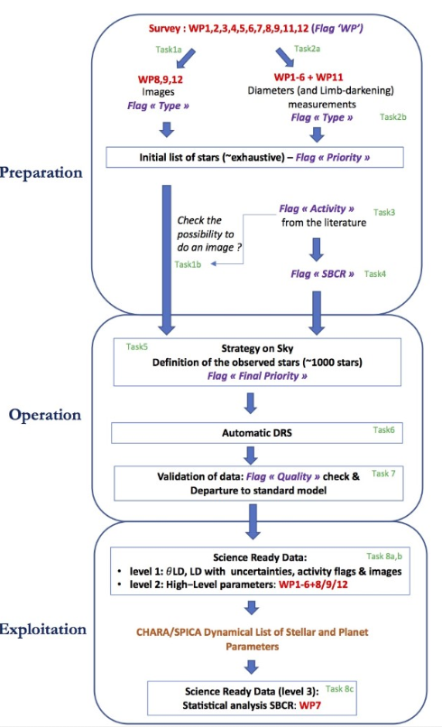
Scientific Survey Management
3 levels of activity
Preparation before the start of the survey
List of stars, python scripts
Database creation
Consolidation of strategy and criteria to validate the science objectives
Operation
Selection of targets in the database with specific criteria
Calibrators
Night strategy
Automatic DRS
Validation of observations
Database feeding
Exploitation
Towards science ready data
Publication of catalogs of parameters
Statistical analysis (SBCR)
Denis Mourard
SPICA-VIS Design Review, July 23-24, 2020

Slide 3
Scientific Survey Management: developments to be done
Preparation
Identification of the sources of data for the different WPs: almost done
Development of python scripts for database queries when needed: a few prototypes exist now.
General python script (merge of all the elementary ones) for a dynamical construction of the list (Gaia DR3 ++)
Definition of the observing strategy for each WP: in progress
Definition of the OB database: in progress. Support proposed by JMMC and Aarhus University
Operations
OB database – ASPRO2 interface: will be based on the ObsPortal principle (new feature in ASPRO2) with additional criteria for selecting targets (night strategy and follow-up of previous achievements)
ASPRO2-CD interface on the A2P2 principle (JMMC ready to help, tests already made)
DRS: see Philippe presentation based on the MATISSE experience
Validation of observations: simple online fit tools after the DRS: criteria to be defined by the science group
OiDB + SPICA_DB + CHARA DataCenter: automatic feeding
Resources to be considered (mainly through the funding support of the Science Group):
Database expert (potential funding support by Aarhus + JMMC)
Postdoc(s): ANR and ERC funding requests
Observing time
Denis Mourard
SPICA-VIS Design Review, July 23-24, 2020

